Slide 1
QUEUE

Slide 2
A queue is a useful data structure in programming. It is similar to the ticket queue outside a cinema hall, where the first person entering the queue is the first person who gets the ticket.
There are four different types of queues:
Simple Queue
Circular Queue
Double Ended Queue

Slide 3
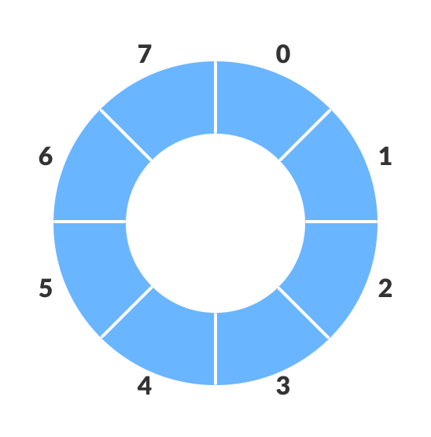
Circular Queue Data Structure
A circular queue is the extended version of a regular queue where the last element is connected to the first element. Thus forming a circle-like structure.

Slide 4
How Circular Queue Works
Circular Queue works by the process of circular increment i.e. when we try to increment the pointer and we reach the end of the queue, we start from the beginning of the queue.
if REAR + 1 == 5 (overflow!), REAR = (REAR + 1)%5 = 0 (start of queue)

Slide 5
Circular Queue Operations
The circular queue work as follows:
two pointers FRONT and REAR
FRONT track the first element of the queue
REAR track the last elements of the queue
initially, set value of FRONT and REAR to -1

Slide 6
1. Enqueue Operation
check if the queue is full
for the first element, set value of FRONT to 0
circularly increase the REAR index by 1 (i.e. if the rear reaches the end, next it would be at the start of the queue)
add the new element in the position pointed to by REAR

Slide 7
2. Dequeue Operation
check if the queue is empty
return the value pointed by FRONT
circularly increase the FRONT index by 1
for the last element, reset the values of FRONT and REAR to -1
However, the check for full queue has a new additional case:
Case 1: FRONT = 0 && REAR == SIZE - 1
Case 2: FRONT = REAR + 1
The second case happens when REAR starts from 0 due to circular increment and when its value is just 1 less than FRONT, the queue is full.

Slide 8
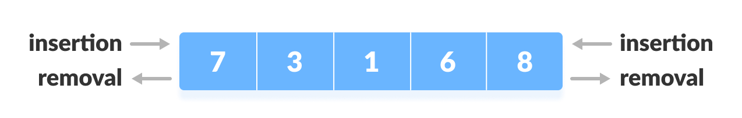
Deque Data Structure
Deque or Double Ended Queue is a type of queue in which insertion and removal of elements can either be performed from the front or the rear. Thus, it does not follow FIFO rule (First In First Out).

Slide 9
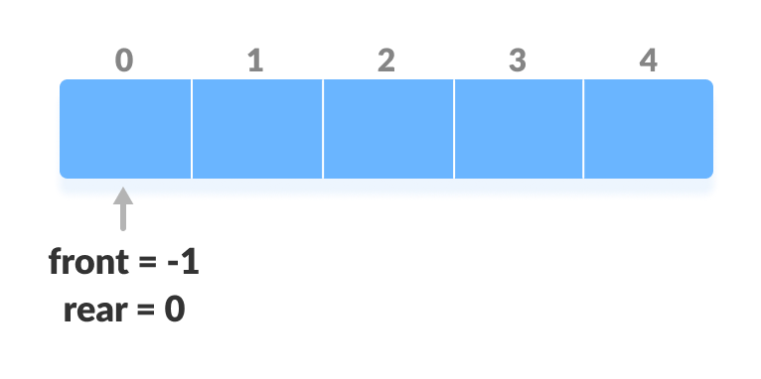
Before performing the following operations, these steps are followed.
Take an array (deque) of size n.
Set two pointers at the first position and set front = -1 and rear = 0.

Slide 10
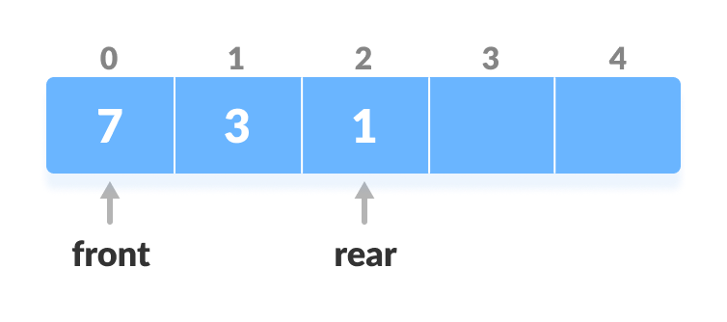
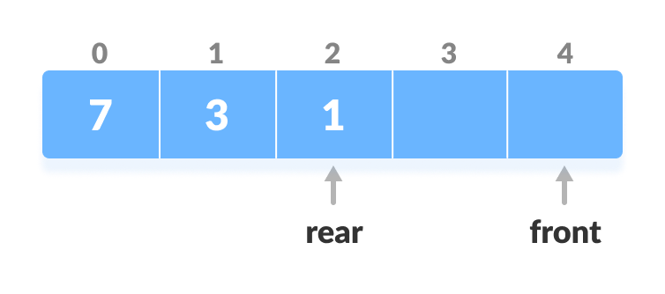
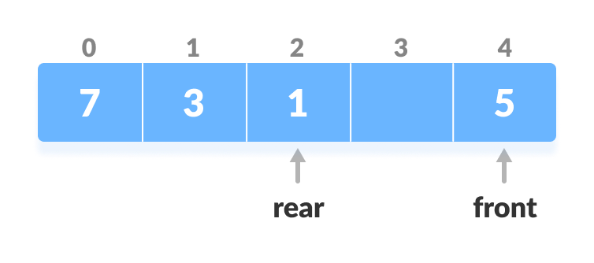
1. Insert at the Front
This operation adds an element at the front.
1. Check the position of front.
2. If front < 1, reinitialize front = n-1 (last index).
3. Else, decrease front by 1.
4. Add the new key 5 into array[front].

Slide 11
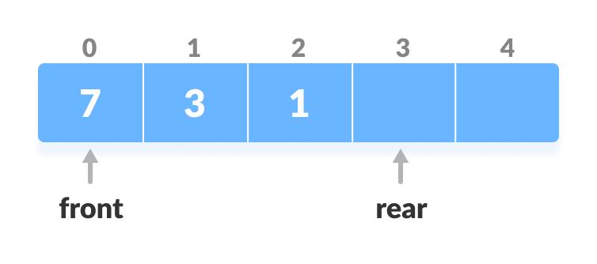
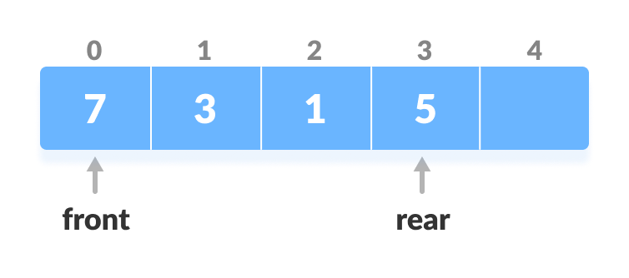
2. Insert at the Rear
This operation adds an element to the rear.
Check if the array is full.
If the deque is full, reinitialize rear = 0.
Else, increase rear by 1.
Add the new key 5 into array[rear].

Slide 12
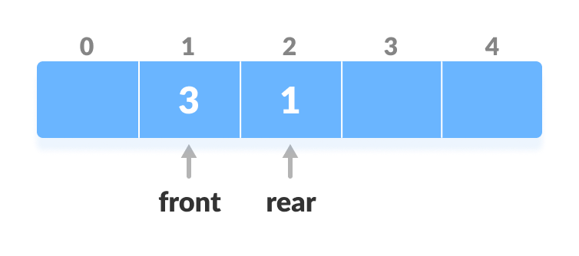
3. Delete from the Front
If the deque is empty (i.e. front = -1), deletion cannot be performed (underflow condition).
If the deque has only one element (i.e. front = rear), set front = -1 and rear = -1.
Else if front is at the end (i.e. front = n - 1), set go to the front front = 0.
Else, front = front + 1
Check if the deque is empty.

Slide 13
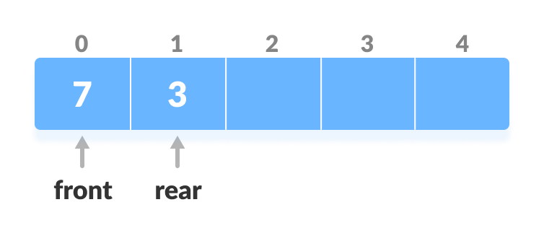
4. Delete from the Rear
If the deque is empty (i.e. front = -1), deletion cannot be performed (underflow condition).
If the deque has only one element (i.e. front = rear), set front = -1 and rear = -1, else follow the steps below.
If rear is at the front (i.e. rear = 0), set go to the front rear = n - 1.
Else, rear = rear - 1

Slide 14
5. Check Empty
This operation checks if the deque is empty. If front = -1, the deque is empty.
6. Check Full
This operation checks if the deque is full. If front = 0 and rear = n - 1 OR front = rear + 1, the deque is full.

